Slide 1

AirAware: Smart Air Quality Prediction Systems
An Infosys virtual internship project by Sharmika Gangadharan.
This project aims to predict and monitor air pollution levels using advanced machine learning and data analysis techniques. The objective is to create a robust system capable of providing accurate forecasts and timely alerts for harmful air quality conditions.

Slide 2

Project Overview: Forecasting Air Quality
AirAware focuses on delivering a comprehensive solution for understanding and mitigating air pollution. The system will leverage historical data to forecast future conditions and provide actionable insights.
Core Objective
Key Indicators
Predict and monitor air pollution levels using machine learning.
Focus on pollutants such as PM2.5, CO₂, NO₂, and other environmental data (e.g., O₃).
Outcome
Generate alerts for harmful or risky air-quality levels.

Slide 3










Priorities & Deliverables
Over the next 45 days, the goal is to build a fully functional system. Key priorities include data acquisition, robust modelling, and clear visualisation.
Dashboard Analysis
Data Storage
Data Preprocessing
Display 3–4 months of air-quality records and their analysis.
Gather and store pollution metrics and weather data in a database.
Clean and preprocess data (normalization, noise removal) before model training.
Model Building
Accuracy Validation
Develop prediction models (SVM, Random Forest, Linear Regression).
Compare forecasted values with actual pollution levels.

Slide 4
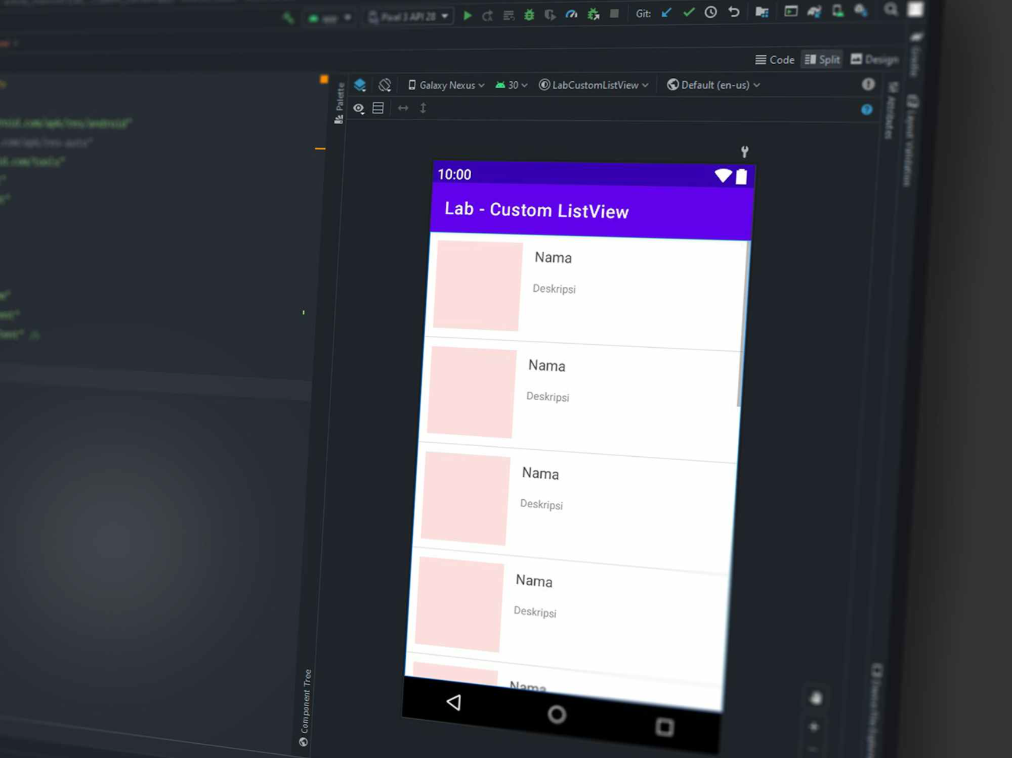

Recommended Technology Stack
A flexible yet powerful tech stack is recommended to ensure scalability and efficiency for AirAware. Developers are encouraged to adapt tools as needed.
Frontend & Visualisation
Backend & Data Management
Frameworks: React.js or Vue.js
Backend: Python (Flask/FastAPI) or Node.js + Express
Charting: Chart.js, Plotly, ECharts, D3.js
Database: MongoDB (JSON datasets) or PostgreSQL (relational queries)
UI: Tailwind CSS, Material UI
ML/Data: Python (Pandas, NumPy, Scikit-learn, XGBoost, Statsmodels)
Optional ML: LSTM (TensorFlow/PyTorch)
Datasets: Kaggle, HuggingFace, Government APIs

Slide 5

System Architecture Overview
The AirAware system is designed with a modular architecture, ensuring clear data flow and efficient processing from external sources to the user interface.
External APIs
Data Collection
Raw & Clean DB
Preprocess & ML
This structured approach allows for robust data handling, accurate predictions, and effective dissemination of air quality insights.

Slide 6

Roadmap: Days 1-12
The initial phases of the project focus on foundational setup, architectural design, and the critical first steps in data collection and database integration.
01
Days 1-5: Setup & Architecture
Finalise tech stack.
Create project repositories and folder structure.
Design initial database schema.
Identify and download 3–4 months of air-quality datasets.
Define pollution parameters (e.g., PM2.5, NO₂, CO₂, O₃).
02
Days 6-12: Data Collection & DB Integration
Import air-quality CSV datasets into your database.
Build backend API endpoints for data fetching and insertion.
Optionally, fetch weather data from open APIs (OpenWeatherMap, IQAir).
Store environmental and weather data daily.

Slide 7

Roadmap: Days 13-30
This phase is dedicated to transforming raw data into a usable format and developing the core machine learning models for prediction.
Days 13-20: Data Cleaning & Preprocessing
Remove missing values.
Handle outliers (IQR or z-score).
Smooth noisy values (rolling averages).
Normalize values (Min-Max or Standard Scaling).
Split dataset into training and testing sets.
Perform feature engineering (e.g., lagged PM2.5, temperature-humidity interactions, AQI labels).
Days 21-30: ML Model Development
Train multiple models: Linear Regression, SVR, Random Forest Regressor, Gradient Boosting.
Evaluate performance using RMSE, MAE, and R² Score.
Select the top-performing model for deployment.

Slide 8
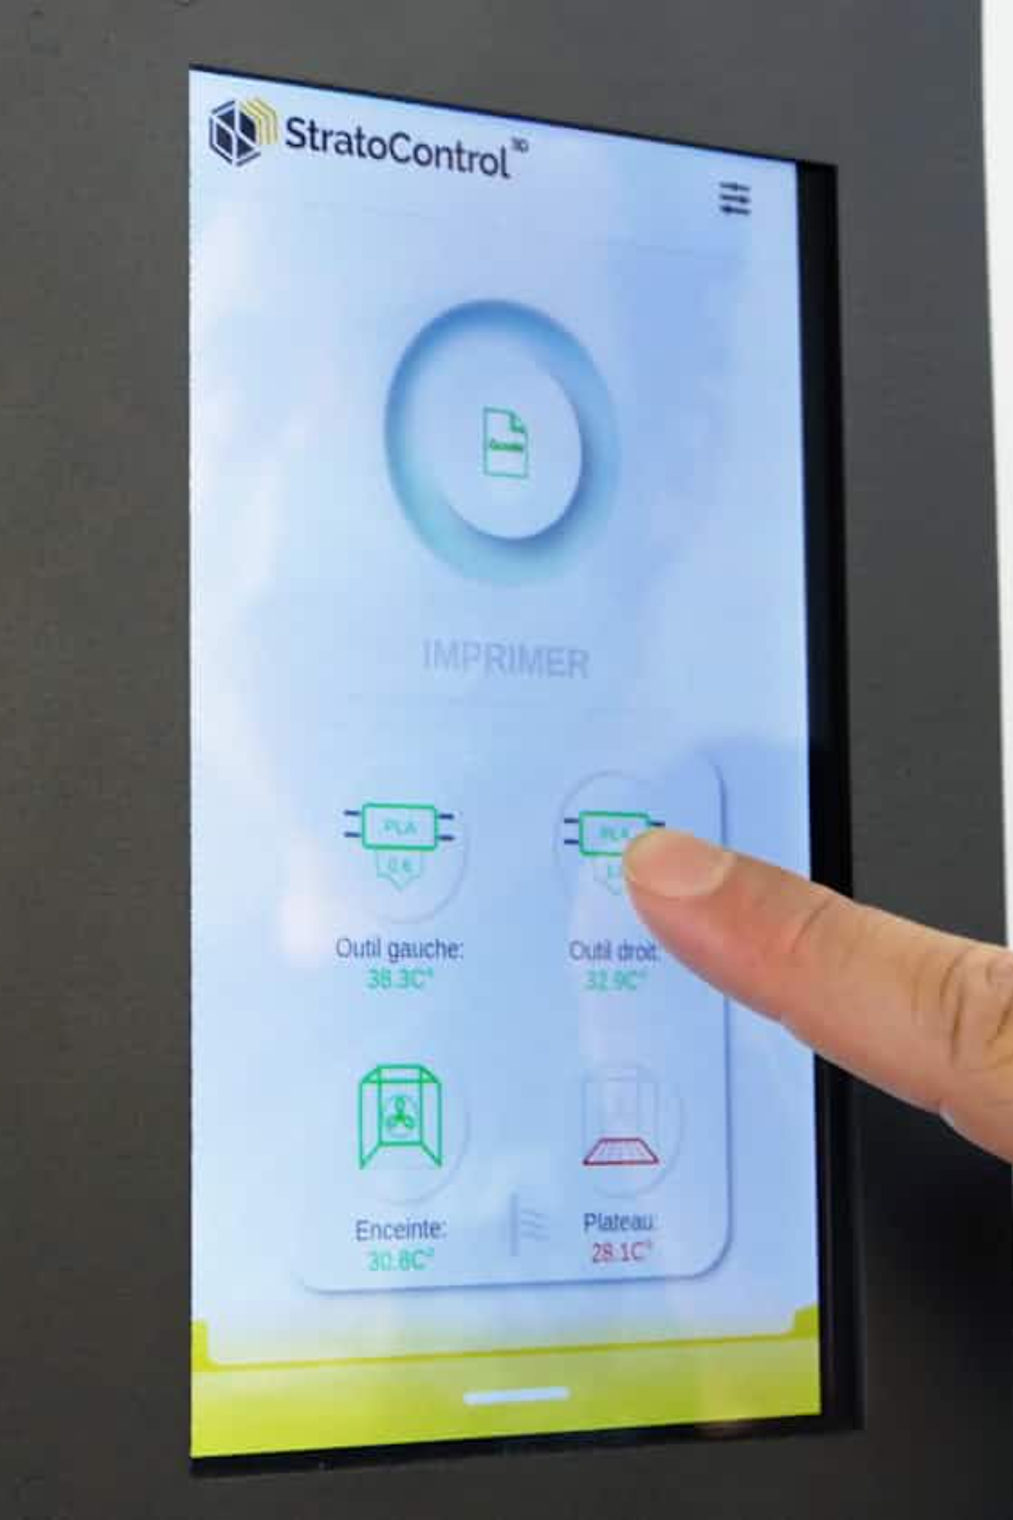

Roadmap: Days 31-42
The focus shifts to integrating the prediction engine, setting up the alert system, and building the interactive frontend dashboard.
1
Days 31-35: Prediction & Alerts
Implement the prediction API endpoint (/predict).
Compare predicted vs. actual pollution values.
Trigger alerts for thresholds (e.g., PM2.5 > 100, NO₂ > safe, CO₂ > 1000 ppm).
Save alerts into the database.
Optional: Implement email or SMS notifications.
2
Days 36-42: Frontend Dashboard
Create a clean, visual dashboard using React and Chart.js/ECharts.
Display current and historical pollution levels.
Show forecasted values via line charts and heatmaps.
Include AQI gauges, alerts, warning banners, and tables of raw/predicted values.

Slide 9




Roadmap: Days 43-45
The final days are dedicated to rigorous testing, optimisation, and deployment, ensuring the AirAware system is robust and ready for use.
Testing
Optimisation
Deployment
Test backend APIs and validate prediction accuracy.
Load-test the dashboard for performance.
Frontend to Vercel/Netlify; Backend to Render/AWS/Railway; Database to MongoDB Atlas/Supabase.

Slide 10
Key Features of AirAware
AirAware is designed to be a comprehensive and proactive solution for air quality management, integrating several critical functionalities.
1
Real-Time Data
Capability for continuous data retrieval and processing.
2
Historical Analysis
Analysis of 3–4 months of past air quality data.
3
Prediction Engine
Robust machine learning models for future air quality forecasting.
4
Alert System
Automated notifications for critical pollution levels.
5
Visual Dashboards
Intuitive and interactive visualisations for insights.
6
API Endpoints
Comprehensive API support for all data operations.

